Slide 1

Pay Transparency:
Good for Women, Good for Business

Slide 2
The legal framework

Slide 3
Fair Work Amendment (Gender Pay Gap) Bill 2015
333B Terms prohibiting disclosure of pay have no effect
A term of a modern award, an enterprise agreement or a contract of employment has no effect to the extent that the term:
(a) prohibits an employee from disclosing the amount of, or information about, the employee’s pay or earnings; or
(b) permits, or has the effect of permitting, an employer to take adverse action against an employee if the employee discloses the amount of, or information about, the employee’s pay or earnings.

Slide 4
Myth #1
Current laws prevent women from being paid less than men for the same work.
Discrimination on the basis of gender is unlawful, but it is not possible to make an anti-discrimination claim if the source of the discrimination is confidential.

Slide 5
Defining the gender pay gap

Slide 6
When the result is a positive number men pay > women pay
When the result is a negative number women pay > men pay

Slide 7
Sources of data
Australian Bureau of Statistics (Full time average weekly ordinary time earnings; collected every six months from over 5,000 employing businesses)
  Not “like for like” pay gaps
  Aggregate pay figures
  KPMG, WGEA
WGEA data (12,000 employers & 4 million employees)
  100 or more employees; base and total remuneration data
  BCEC (Bankwest Curtain and WEGA)
HILDA (23,000 individuals)
  Aggregate pay figures; contextual data
  KPMG used HILDA

Slide 8


Slide 10


Slide 12
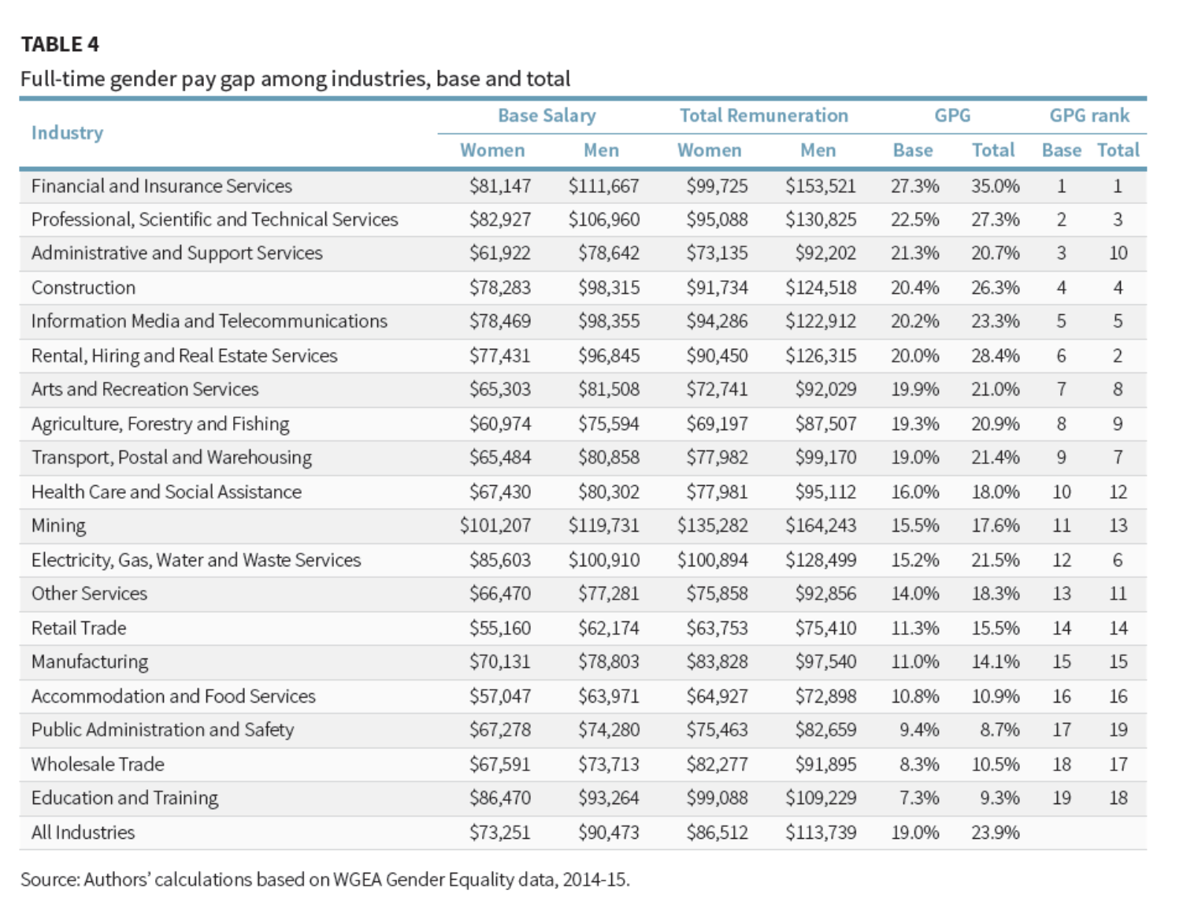

Slide 14
Pay gap in the legal sector
  Women earn 27% less in total remuneration than men.
  Women working full-time earn 31% less than men.
  Women working part-time earn 29% less than men.

Slide 15
Myth #2
The pay gap doesn't affect younger women at the start of their careers.
The pay gap begins at 12% for people aged under 17 and 6% for graduates. It increases with age and seniority.
Source: Workplace Gender Equality Agency, GradStats – Starting Salaries, January 2015

Slide 16
Defining pay transparency

Slide 17
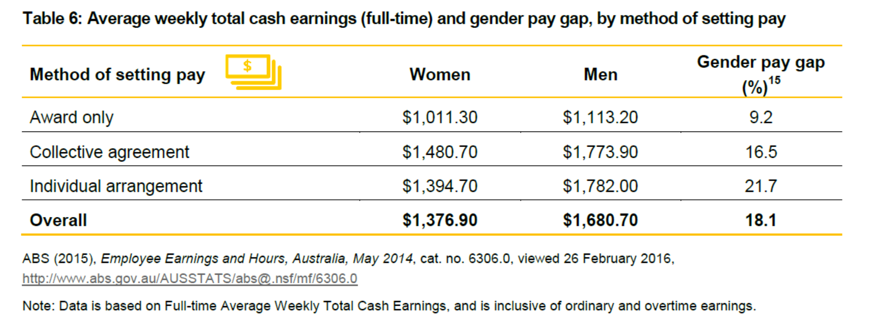
The advent of pay secrecy in Australia.

Slide 18

How pay secrecy contributes to the gender pay gap
Impact on decision making: conscious or unconscious bias and stereotyping can affect pay decisions; face time” (time in the workplace) or “perceived similarity”
  Performance evaluation ratings for men and women
Unequal access to information: difficult for women to compare their pay to similarly situated employees →cannot challenge

Slide 19
What pay transparency looks like: a continuum from completely secret to totally transparent
“.. a restriction of the amount of information employees are provided about what others are paid” (Colella, Paetzold, Zardkoohi, & Wesson, 2007)
Many dimensions of pay
“…when we speak of pay secrecy, we are talking about the lack of information that employees have about the level of other employees’ pay in the organization” (Colella, Paetzold, Zardkoohi, & Wesson, 2007)

Slide 20
How pay transparency can reduce the gender pay gap
Pay secrecy in the US:
  Kim (2015) after taking into account personal and economic factors found that women’s wages are higher (between 4 – 12% depending on how the data was analysed) in those states with pay secrecy laws relative to the non-pay secrecy law states.
Rationale decision making
  Accountability
Unaccountable decision makers
  less consistency and stability in their judgements (Hagafors and Brehmer, 1983)
  less responsive to evidence when evaluating others (Rozelle and Baxter, 1981).
  Show less analytical effort in their decision making (Tetlock, 1985).
  less likely to produce high quality and rational decisions (Tetlock and Kim, 1992)
  less likely to base their decisions on available information (Tetlock, 1985).

Slide 21
Arguments against pay transparency and why they are wrong
Issue | Claim | Evidence
Productivity | Higher pay dispersion | Obscures the link between pay and performance High performers – low performers
Conflict between employees | Employees will argue about pay | Positional cues → Estimates of co worker pay (next slide) Conflict when ad hoc system
Trust | Management can allocate fairly | Pay secrecy suggests lack of trust in employees; something to hid Impact on other aspects of the organisation
Attraction and retention | Stops poaching | Pay is not usually the reason employees change jobs

Slide 22
What we believe about pay

Slide 23
Examples of successful pay transparency practices: current trends
The proportion of companies enforcing pay secrecy in the US has declined from 75% in 1985 to 23% in 2010 (Marasi & Bennett, 2016)
Reddit, an online news service recently announced a take it or leave it pay policy for starting salaries as a way to avoid private negotiations and differential starting salaries (Feintzeig & Silverman, 2015)
Massachusetts has become the first state to bar employers from asking about applicants’ salaries before offering them a job. The new law in MA will require hiring managers to state a compensation figure upfront — based on what an applicant’s worth is to the company, rather than on what he or she made in a previous position

Slide 24
Attitudes to pay information
(Giancola et al, 2014: pp165-166)
A survey of 1,205 managers found the following % of managers favouring release of pay information
8% | Release of individual salaries to all employees
55% | More information on pay levels is desirable
85% | Position in range should be told to each employee
93% | The range of merit increases should be made public for each pay grade
18% | Salary information should be made more secret

Slide 25
Myth #3
Women are not assertive and do not ask for pay rises.
There is no difference in the likelihood of asking between women and men.
Source: Do Women Ask? Warwick Economics Research Paper Series, September 2016.
When women act more assertively, they can be perceived as less competent and less likable.
Source: Who Takes the Floor and Why - Gender, Power, and Volubility in Organizations, Administrative Science Quarterly 56.4 (2011)

Slide 26
Where to now?

Slide 27
Myth #4
It is all about women's life choices.
“Until it is culturally accepted and economically feasible for men to take equal time out of the workforce to care for children, this is not a ‘choice’ made freely.”
  Source: KMPG, She’s Price(d)less – The Economics of the Gender Pay Gap

Slide 28
How to take action
Visit www.vwl.asn.au to access:
  a range of gender pay gap resources, including questions to ask your employer and legal sector case studies;
  VWL’s submissions to the Senate on the Fair Work Amendment (Gender Pay Gap) Bill 2015; and
  notifications of future events and updates on this project.
Visit the Workplace Gender Equality Agency website for tools to conduct a pay gap analysis and create a pay equity strategy.

Slide 29
Questions?
contact@vwl.asn.au

